Slide 1

COMPUTER SCIENCE MINI-PROJECT-2 PROJECT-TITLE: SMART HEALTH MONITORING SYSTEM USING EMBEDDED TECHNOLOGY
INNOVATING ACCESSIBLE HEALTHCARE WITH EMBEDDED TECHNOLOGY
PRESENTED BY: PRAMODH NARAIN
CHANNEL: PRAMODH CODE CRAFTER
DATE: 19-11-2024

Slide 2
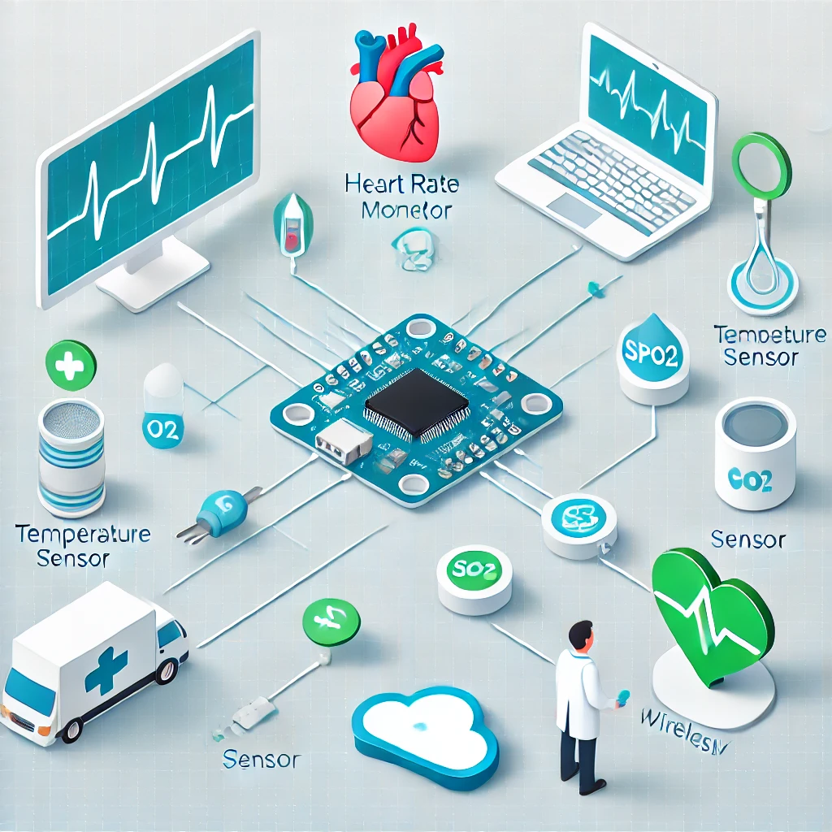
INTRODUCTION
What are embedded systems ?
Importance of health monitoring in today’s world.
Project Focus: Developing a cost-effective, real-time health monitoring system.

Slide 3

OBJECTIVE
Collect real-time health data (heart-rate, temperature , SpO₂) .
Display locally or transmit to a server/cloud.
Alert caregivers during emergencies.

Slide 4
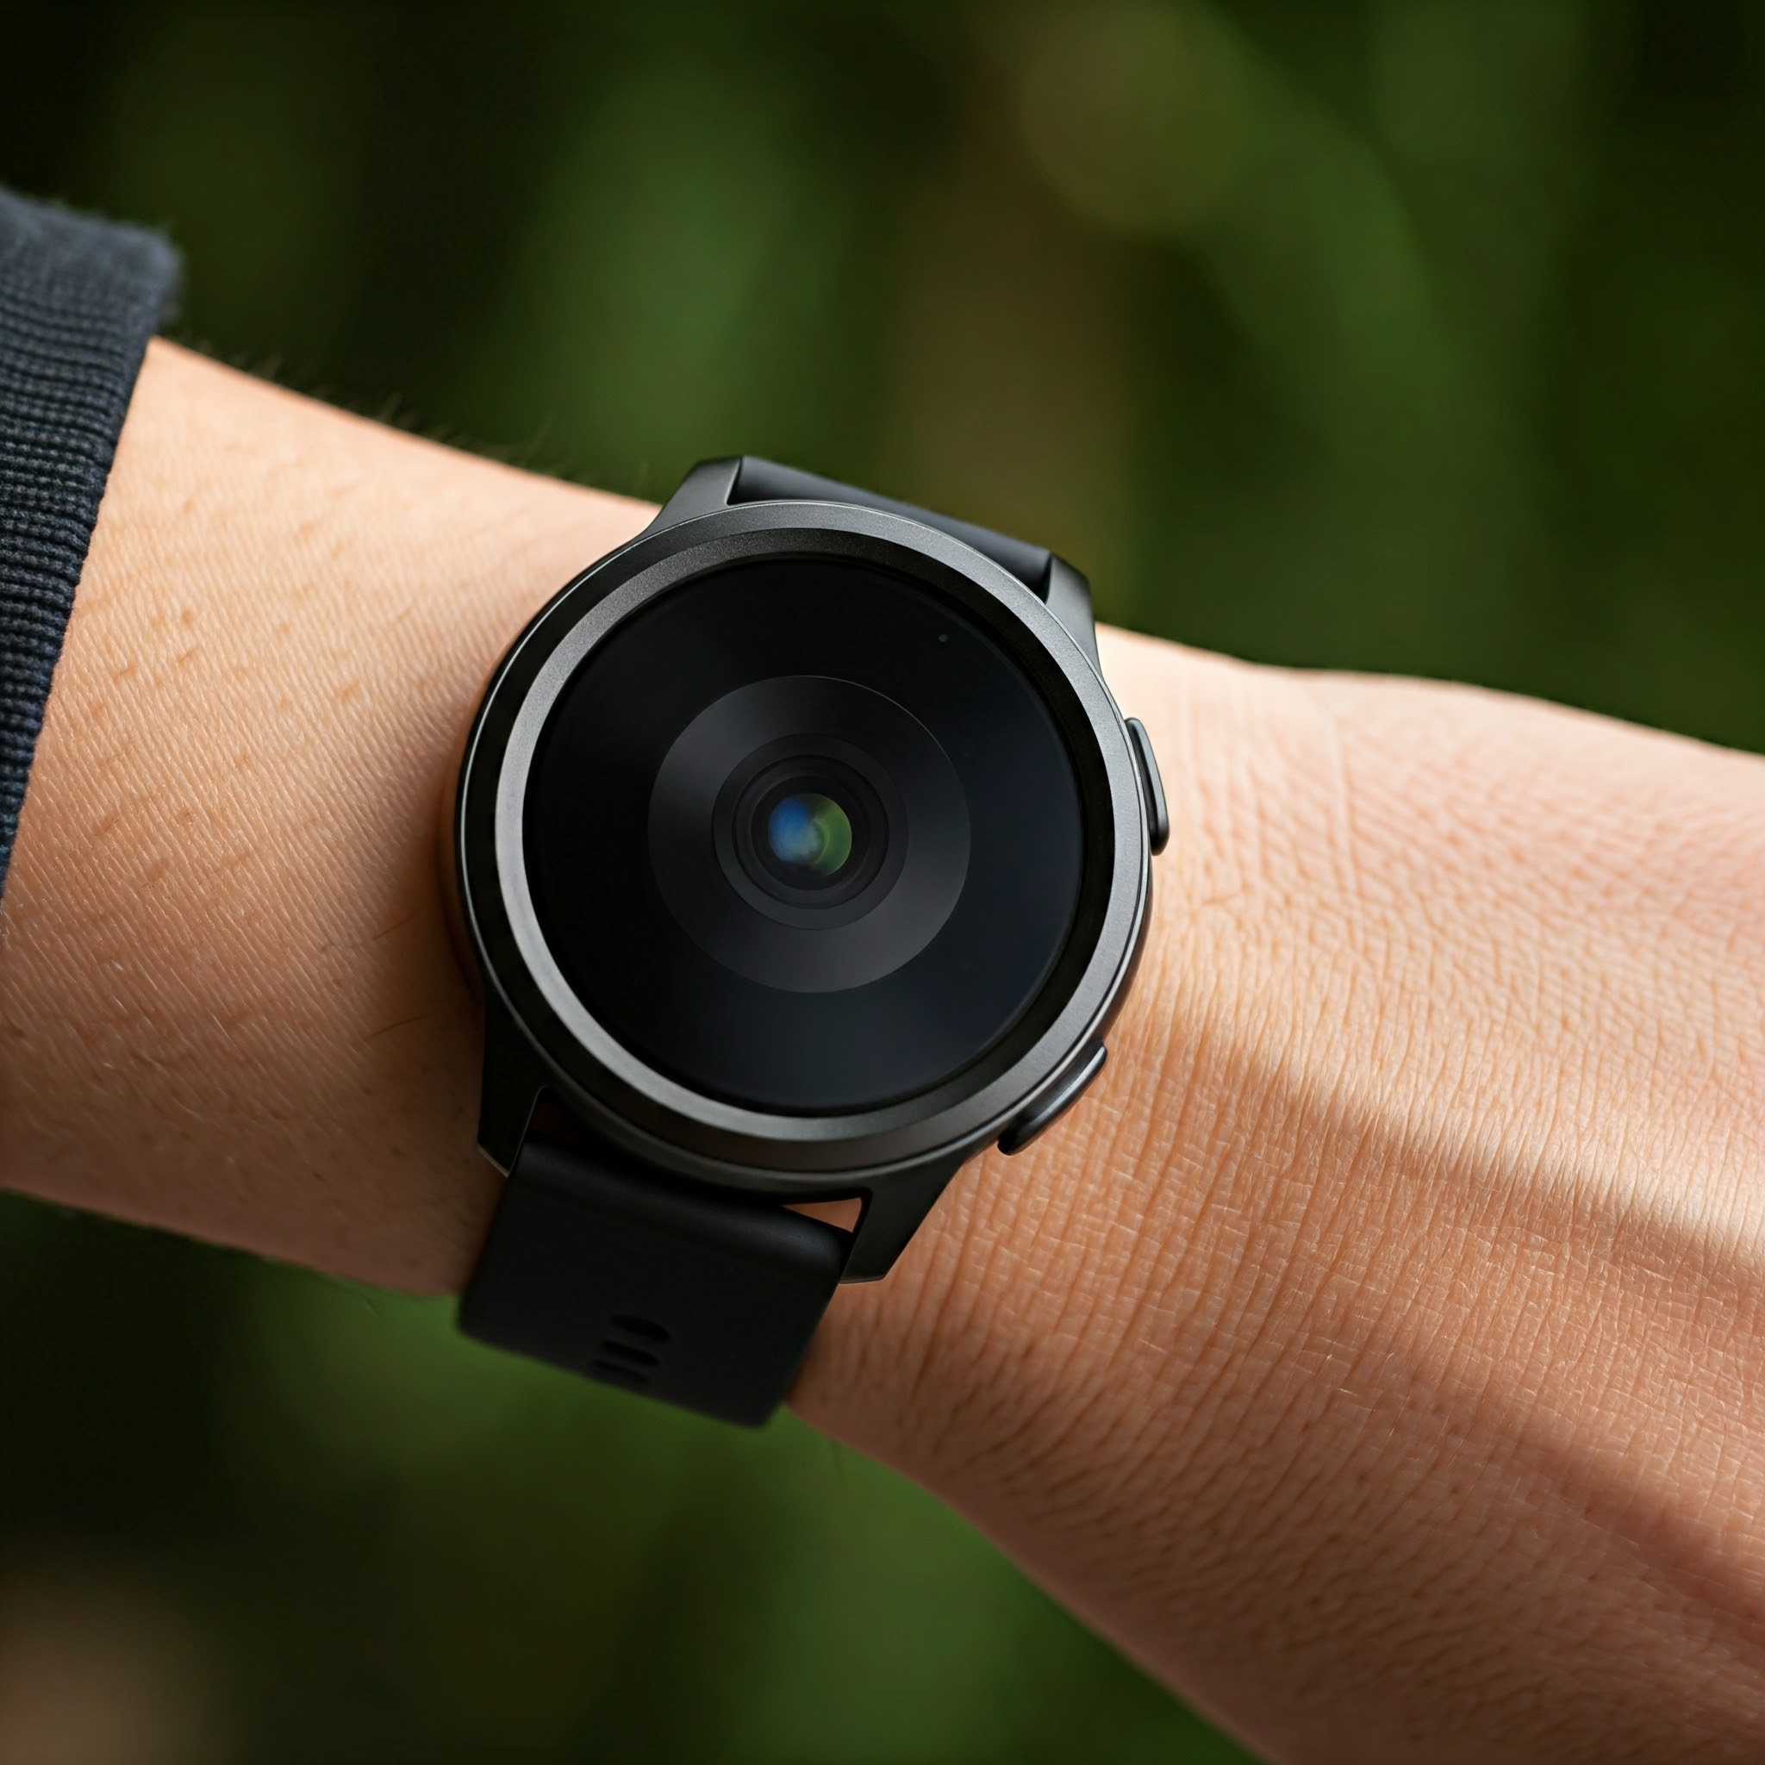
LITERATURE REVIEW
BACKGROUND RESEARCH
Rise of wearable devices like Fitbit and Apple Watch.
Suitability of microcontrollers for low-power, real-time monitoring.
Importance of wireless protocols (e.g., BLE, Wi-Fi).

Slide 5
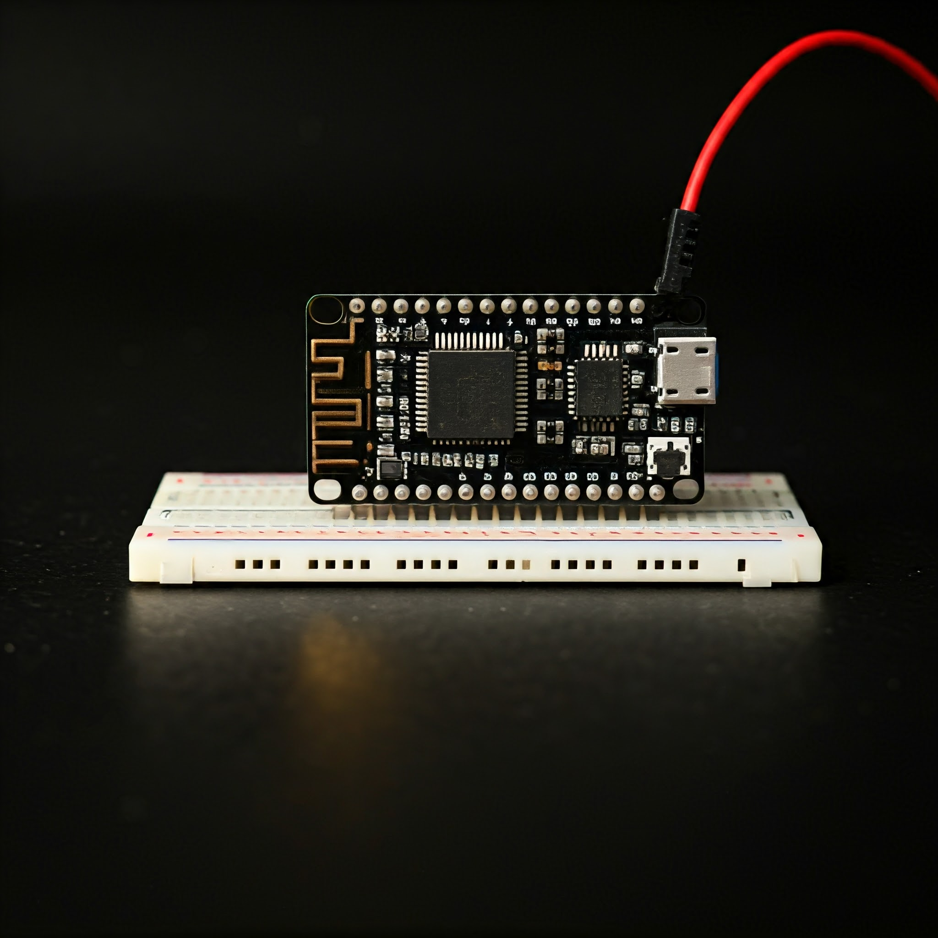
SYSTEM DESIGN (HARDWARE) HARDWARE COMPONENTS
Microcontroller:
ESP32 for processing and connectivity.
Sensors:
Heart Rate (MAX30102), Temperature (LM35), SpO₂
Display:
OLED (128x64)
Power Source:
Lithium Polymer Battery.

Slide 6
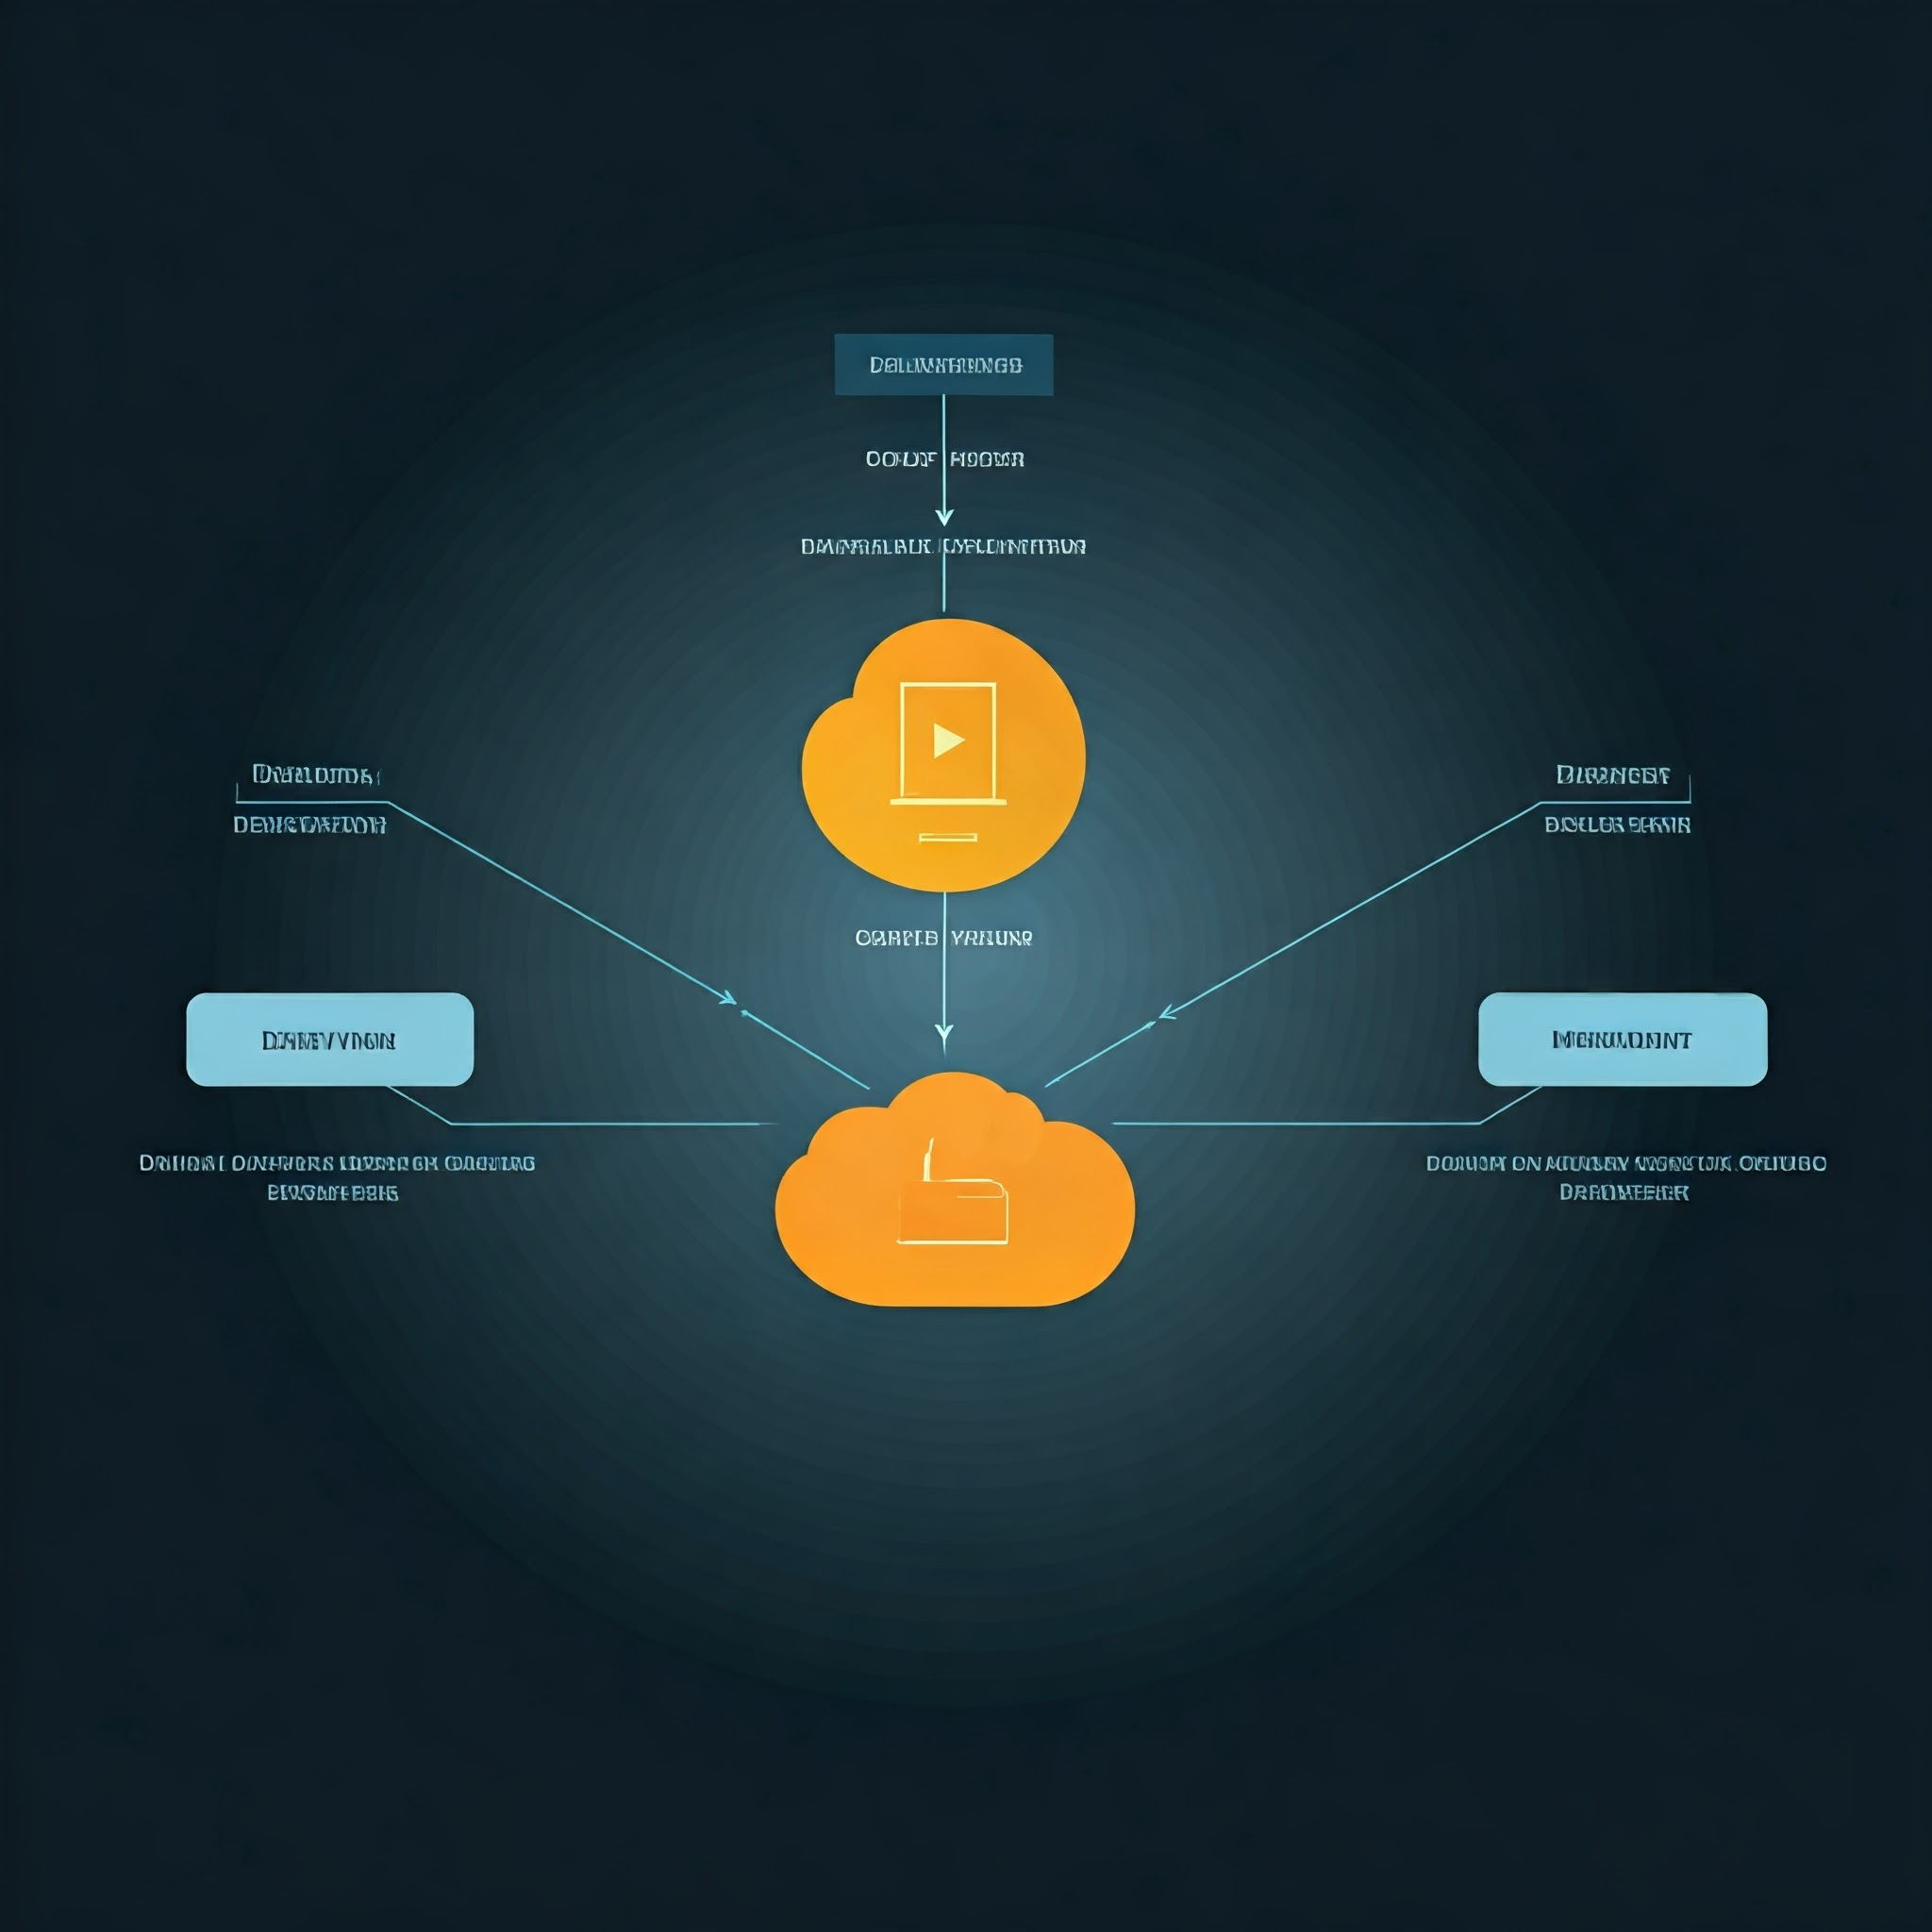
SYSTEM DESIGN (SOFTWARE) SOFTWARE COMPONENTS
Embedded C programming for data collection and processing.
Bluetooth or Wi-Fi for communication.
Cloud storage and visualization using Firebase or AWS IoT.

Slide 7
METHODOLOGY HOW IT WORKS
SENSOR PROECESSES DATA
MICROCONTROLLER PROCESSED DATA
DATA TRANSMITTED/STORED
ALERTS TRIGGERED

Slide 8

Challenges and solutions
Challenges:
Sensor calibration accuracy.
Power management for extended usage.
Solutions:
Careful sensor tuning.
Use of low-power components like ESP32.

Slide 9
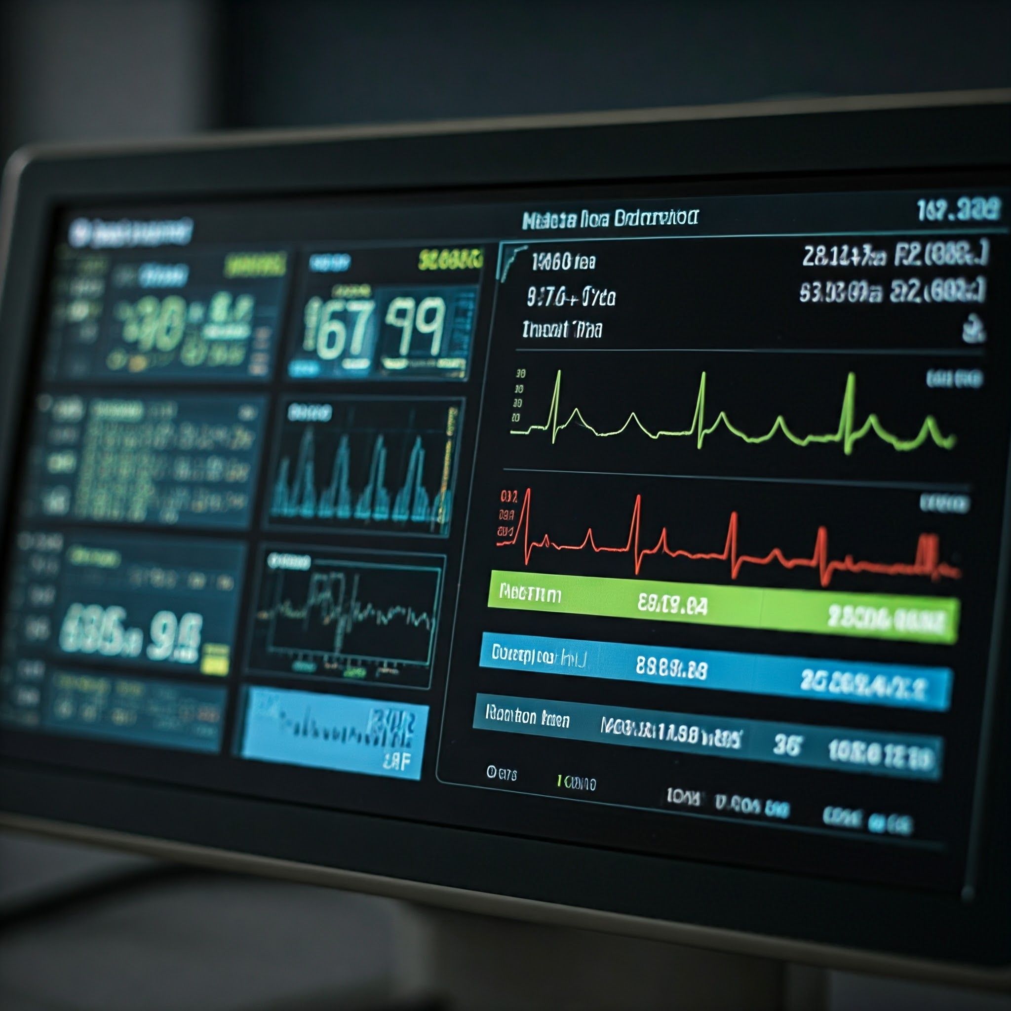
APPLICATIONS
Remote health monitoring for rural areas.
Emergency medical alerts for critical conditions.
Integration with telemedicine platforms.

Slide 10
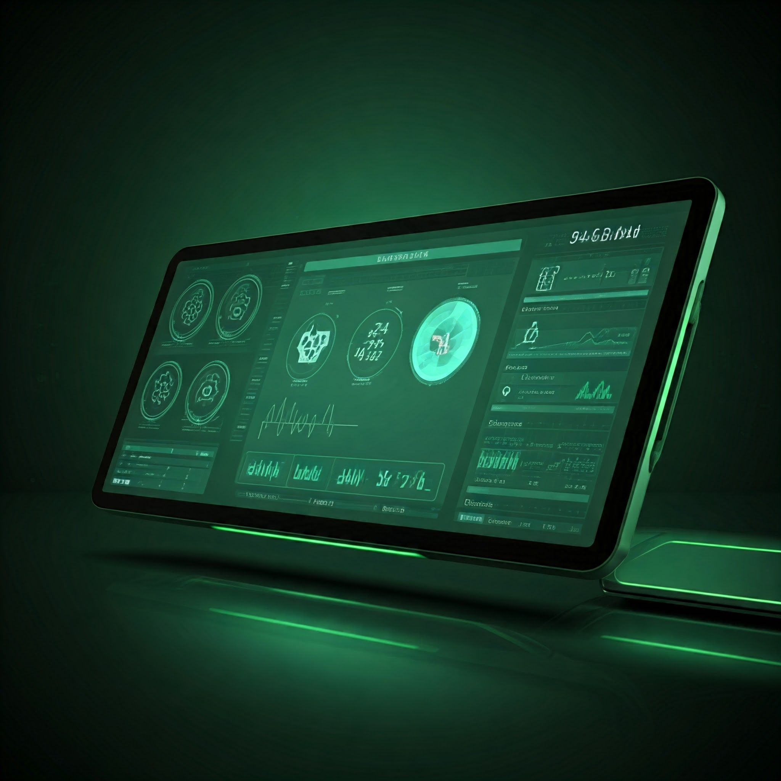
CONCLUSION
The Smart Health Monitoring System demonstrates the potential of embedded systems in transforming healthcare.
Future Scope: Enhanced features like ECG monitoring or AI-based analytics.

Slide 11

Q & A QUESTIONS AND FEEDBACK
Thank you for your attention!
Feel free to ask any questions or share feedback

Slide 12


